Slide 1
PROBABILITY AND STATISTICS
PROJECT

Slide 2
TOPIC:
Effect Of ICT On Creativity And Innovative Skills

Slide 3
Background :
There is no denying that young people have embraced the digital world. They are unlearned learners of ICT. The use of technology can be beneficial as well as harmful at the same time. So the best uses of digital media technology in education must be impacted by an innovative mindset.

Slide 4
Motivation
Explore peoples perception and view point towards the use of ICT on creativity and innovation.
Evaluate the impact of ICT on students creative mindsets and innovative skills
Analysing views of different age groups on Technology and it’s impact.
Analysing how often Internet is being used by student in their work how it helps them and to what extinct it can be a harm to their creative skills.

Slide 5
We’ve collected Data from 200 people in this survey.

Slide 6
1) Are you a :

Slide 7
2) What is your social screen timing?

Slide 8
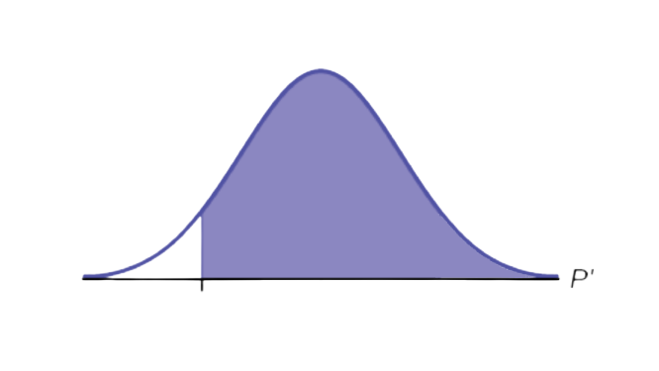
2) What is your social screen timing
Confidence Interval : 0.5087 > p > 0.371
Claim : At least 60% population have
screen time 3-4 hours daily.
Test
H0 : 3-4 hours >= 0.6
Ha : 3-4 hours < 0.6
Zcal : -4.6188022
Zcal is in rejection area so we accept Ha.
-1.645
-4.6188

Slide 9
3) From 1–10, at what point do you rate your creative skills?

Slide 10
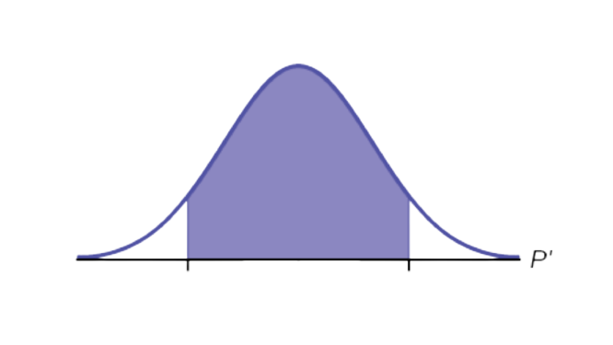
3) From 1–10, at what point do you rate your creative skills?
Confidence Interval : 11.459 > μ > 2.5408
Claim : mean = 8
Test
H0 : population mean = 8
Ha : population mean ≠ 8
Sample mean : 7
Sample std : 2.2750
Zcal : -6.2161
Zcal is in rejection area so we accept Ha.
-1.96
1.96
-6.2161

Slide 11
5) To what extent do you think you are dependent on Technology for your work?

Slide 12
5) To what extent do you think you are dependent on Technology for your work?
Confidence Interval : 13.3415 > μ > 2.6584
Claim : mean = 8
Test
H0 : population mean = 8
Ha : population mean ≠ 8
Sample mean : 8
Sample std : 2.72528
Zcal : 0
Zcal is not in rejection area so we accept H0.
-1.96
1.96
0

Slide 13
6) How much important role does Technology play for your work or projects in daily routine?

Slide 14
6) How much important role does Technology play for your work or projects in daily routine?
Confidence Interval : 0.5442 > p > 0.4057
Claim : At least 50% population have
Extremely important role of
technology
Test
H0 : Extremely important >= 0.5
Ha : Extremely important < 0.5
Zcal : -0.707107
Zcal is not in rejection area so we accept H0.
-1.645
-0.7071

Slide 15
7) How often do you search for Ideas on the Internet for your design work and projects?

Slide 16
7) How often do you search for Ideas on the Internet for your design work and projects?
Confidence Interval : 0.7822 > p > 0.6577
Claim : At least 70% population search
Extremely often and often
Test
H0 : Extremely often and often >= 0.7
Ha : Extremely important and often < 0.7
Zcal : 0.6172
Zcal is not in rejection area so we accept H0.
-1.645
0.6172

Slide 17
8) Do you exactly copy what you see on the internet related to your work or project?

Slide 18
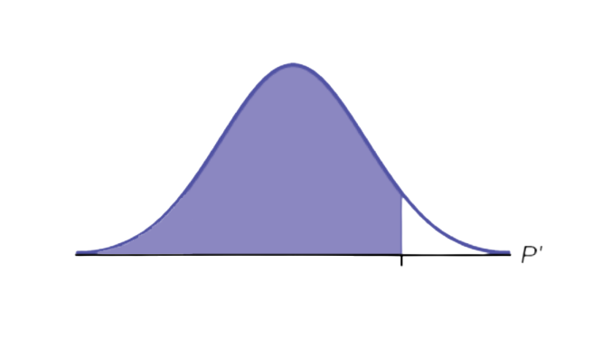
8) Do you exactly copy what you see on the internet related to your work or project?
Confidence Interval : 0.2051 > p > 0.1048
Claim : At most 30% population copy
often
Test
H0 : often <= 0.7
Ha : often > 0.7
Zcal : -4.478
Zcal is not in rejection area so we accept H0.
1.645
-4.478

Slide 19
9) How often do you modify what you see on the Internet to make it your own?

Slide 20
9) How often do you modify what you see on the Internet to make it your own?
Confidence Interval : 0.4317 > p > 0.2982
Claim : At least 50% population modify
often
Test
H0 : often >= 0.5
Ha : often < 0.5
Zcal : -3.818
Zcal is in rejection area so we accept Ha.
-1.645
-3.818

Slide 21
10) Do you think about the design project or work given and come up with original ideas before going to the Internet?

Slide 22
10) Do you think about the design project or work given and come up with original ideas before going to the Internet?
Confidence Interval : 0.5892 > p > 0.4507
Claim : At least 50% population think often
and extremely often
Test
H0 : often and extremely often >= 0.5
Ha : often and extremely often < 0.5
Zcal : 0.5656
Zcal is not in rejection area so we accept H0.
-1.645
0.5656

Slide 23
11) To what extent is Technology/internet helpful to you to explore for brainstorming ideas?

Slide 24
11) To what extent is Technology/internet helpful to you to explore for brainstorming ideas?
Confidence Interval : 0.4730 > p > 0.3369
Claim : At least 50% population think often
Test
H0 : often >= 0.5
Ha : often < 0.5
Zcal : -2.687
Zcal is in rejection area so we accept Ha.
-1.645
-2.687

Slide 25
12) To what extent do you see the change in the quality of work with the use of Technology/Internet and without it?

Slide 26
12) To what extent do you see the change in the quality of work with the use of Technology/Internet and without it?
Confidence Interval : 0.5138 > p > 0.3761
Claim : At least 60% population think
somewhat changed
Test
H0 : somewhat changed >= 0.6
Ha : somewhat changed < 0.6
Zcal : -4.474
Zcal is in rejection area so we accept Ha.
-1.645
-4.474

Slide 27
13) How is the change in your work?

Slide 28
13) How is the change in your work?
Confidence Interval : 0.8951 > p > 0.7948
Claim : 70% population have
improved work
Test
H0 : improved work = 0.7
Ha : improved work ≠ 0.7
Zcal : 4.4747
Zcal is in rejection area so we accept Ha.
-1.96
1.96
4.4747

Slide 29
14) Have your Innovative skills changed over time with the use of Technology?

Slide 30
14) Have your Innovative skills changed over time with the use of Technology?
Confidence Interval : 0.74465 > p > 0.6135
Claim : 65% population say yes
Test
H0 : yes = 0.65
Ha : yes ≠ 0.65
Zcal : 0.8895
Zcal is in rejection area so we accept Ha.
-1.96
1.96
0.8895

Slide 31
15) How much do you consider that Technology/Internet is the reason for the change in your Innovative skills over time?

Slide 32
15) How much do you consider that Technology/Internet is the reason for the change in your Innovative skills over time?
Confidence Interval : 6.3082 > μ > 1.6917
Claim : mean = 3
Test
H0 : population mean = 3
Ha : population mean ≠ 3
Sample mean : 4
Sample std : 1.17768
Zcal : 12.0084
Zcal is in rejection area so we accept Ha.
-1.96
1.96
12.008

Slide 33
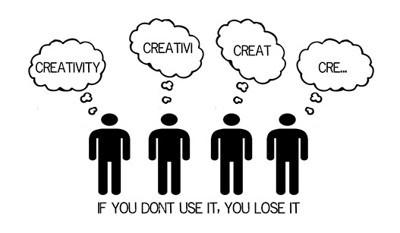
Conclusion
It is concluded from the survey that most of the people are relying the use of ICT and it is actually effecting their innovative skills
They prefer to use technology even before using their own intellect.
One of the potential solution is that “Think before you google it” because creativity is a thing if you don’t use it, you lose it!
Solution

Slide 34



